Slide 1
Course Overview

Slide 2
Python 2 vs Python 3

Slide 3
Python 2 vs 3
Choosing between Python 2 vs 3 used to be a very difficult decision for newcomers to the Python programming language.
Many companies still had legacy Python 2 code to be maintained.

Slide 4
Python 2 vs 3
This course was initially released teaching both versions of Python (2 and 3).
The versions were similar enough that it was easy to learn both simultaneously.
Now every major external python package has been updated to support Python 3!

Slide 5
Python 2 vs 3
This course now focuses solely on Python 3.
All the code, notebooks, and videos have been updated to Python 3.
If need be, going back to Python 2 syntax is a very easy jump once you know Python 3.

Slide 6
Python 2 vs 3
Python 3 is the future of Python.
We use Python 3 for this course.
Old notebooks are available in case you need Python 2 information.
Let’s get started by installing Python 3!

Slide 7
Command Line
Crash Course

Slide 8
CLI Crash course
Before we install anything, its important to have a very quick overview of how to work at the command line.
This allows you to programmatically move through your computer’s directories.

Slide 9
CLI Crash course
We will cover:
Find your current directory
Listing all files in a directory
How to change directory
How to clear the command line screen

Slide 10
Python Overview

Slide 11
Python Overview
In this lecture we will do a brief overview of what Python is, why choose Python for programming, and what you can do with Python.
This lecture in particular is geared towards people new to programming.

Slide 12
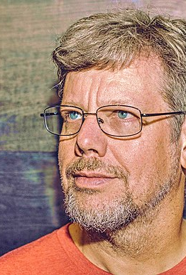
Python Overview
Brief History of Python
Created in 1990 by Guido van Rossum
Python 3 released in 2008

Slide 13
Python Overview
Brief History of Python
Specifically designed as an easy to use language
High focus on readability of code

Slide 14
Python Overview
Why Choose Python?
Designed for clear, logical code that is easy to read and learn.
Lots of existing libraries and frameworks written in Python allowing users to apply Python to a wide variety of tasks.

Slide 15
Python Overview
Why Choose Python?
Focuses on optimizing developer time, rather than a computer’s processing time.
Great documentation online:
docs.python.org/3

Slide 16
Python Overview
What can you do with Python?
This course first focuses on “base” Python, which consists of the core components of the language and writing scripts and small programs.
Later we begin to learn about outside libraries and frameworks that greatly expand Python’s capabilities.

Slide 17
Python Overview
What can you do with Python?
Automate simple tasks
Searching for files and editing them
Scraping information from a website
Reading and editing excel files
Work with PDFs
Automate emails and text messages
Fill out forms

Slide 18
Python Overview
What can you do with Python?
Data Science and Machine Learning
Analyze large data files
Create visualizations
Perform machine learning tasks
Create and run predictive algorithms

Slide 19
Python Overview
What can you do with Python?
Create websites
Use web frameworks such as Django and Flask to handle the backend of a website and user data
Create interactive dashboards for users

Slide 20
Python Overview
Once you understand base Python and begin working with a few libraries, you’ll quickly begin to see the vast potential Python has for your own projects!
Let’s get started with setting you up for the course!

Slide 21
Installing Python

